Slide 1
Optical Character Recognition
Rohith Saxena (RA2011026010250)
Anish Parkhe (RA2011026010285)

Slide 2
Abstract
Optical Character Recognition, also known as Text Recognition, is a technology capable of converting printed or handwritten characters into machine-readable text. OCR makes use of both hardware and software tools.
Optical Character Recognition is a classification problem, which means it is a Machine Learning problem where the output is categorical (i.e. it belongs to a finite set of values).

Slide 3
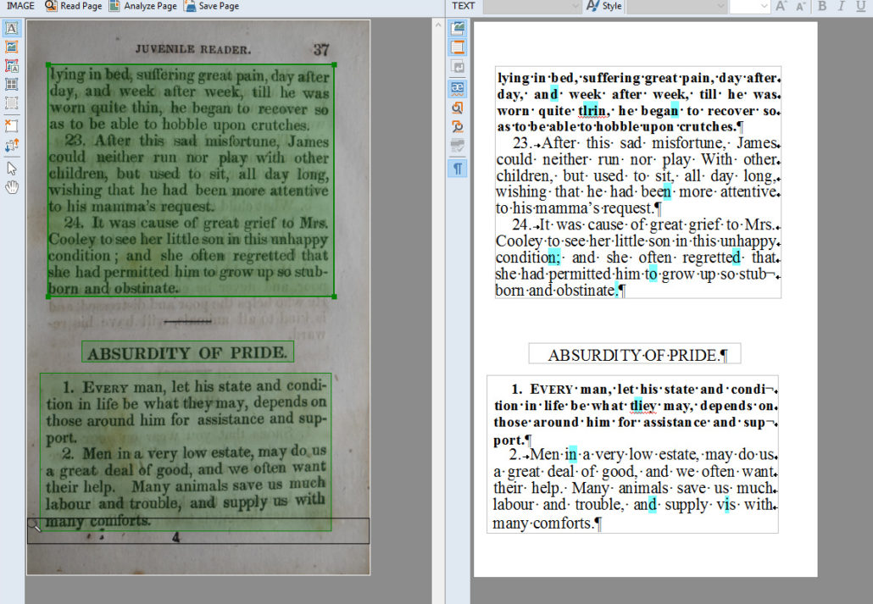
Optical Character Recognition
OCR stands for "Optical Character Recognition." It is a technology that recognizes text within a digital image. It is commonly used to recognize text in scanned documents and images.

Slide 4
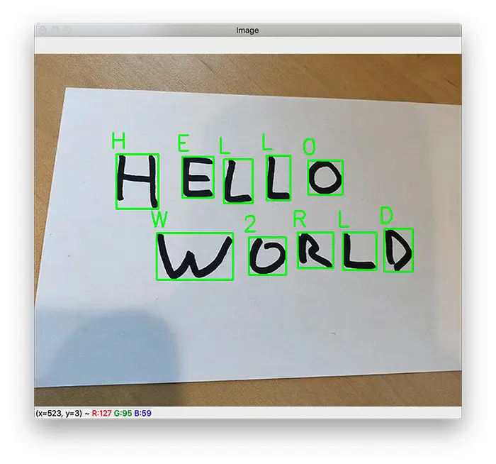
Applications of Optical Character Recognition
OCR can be used for a variety of applications, including the following: Scanning printed documents into versions that can be edited with word processors, like Microsoft Word or Google Docs. Indexing print material for search engines. Automating data entry, extraction and processing.

Slide 5
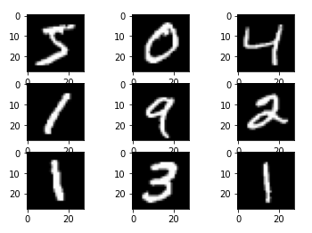
Dataset
MNIST set is a large collection of handwritten digits. It is a very popular dataset in the field of image processing. It is often used for benchmarking machine learning algorithms. MNIST is short for Modified National Institute of Standards and Technology database.

Slide 6
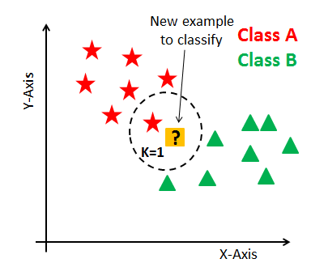
K-Nearest Neighbours
K-Nearest Neighbors Algorithm. The k-nearest neighbors algorithm, also known as KNN or k-NN, is a non-parametric, supervised learning classifier, which uses proximity to make classifications or predictions about the grouping of an individual data point.

Slide 7
K-Nearest Neighbours Classifier
The idea behind KNN is that an example i has a high probability of belonging to a particular class, let’s call it m, if m is also the most popular class of the k nearest examples in the feature space.
the KNN learning algorithm follows these steps:
Given one unknown example, measure its distance from all the labeled examples in the dataset
Take the k labeled examples that are nearest to the unlabeled one
Based on the classes of the k nearest neighbors, predict the class of the unlabeled example
Repeat steps 1–3 for all the unlabeled examples.

Slide 8
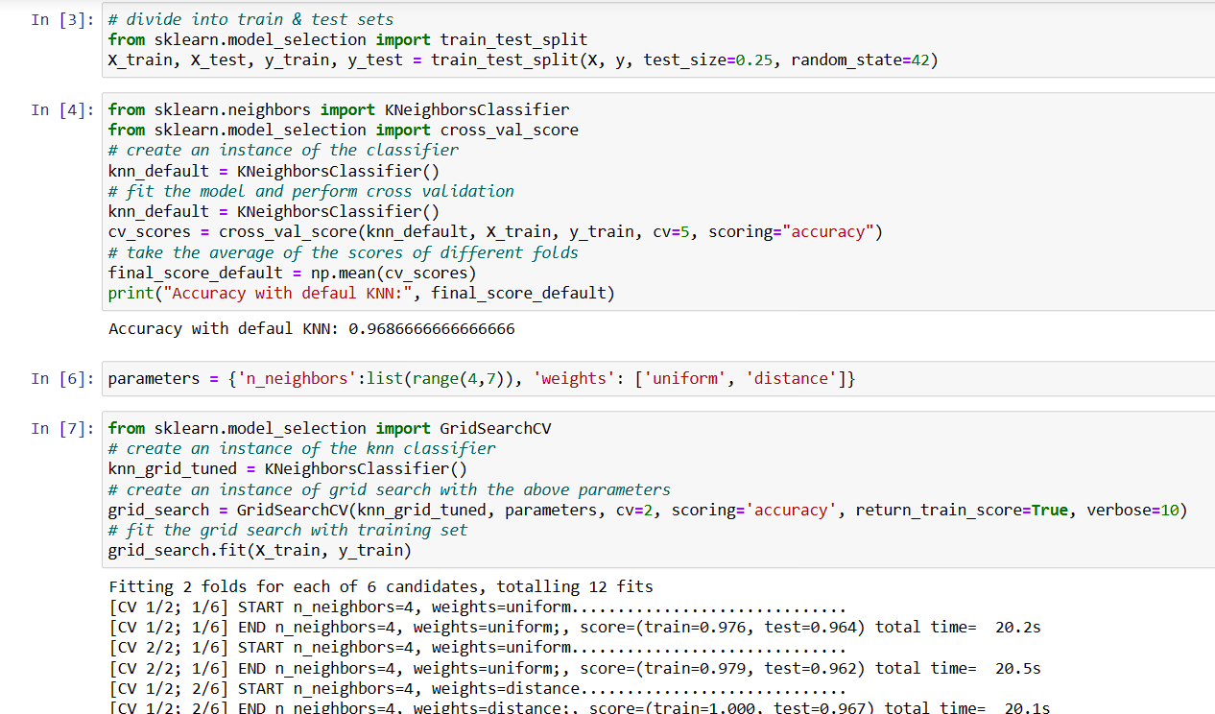
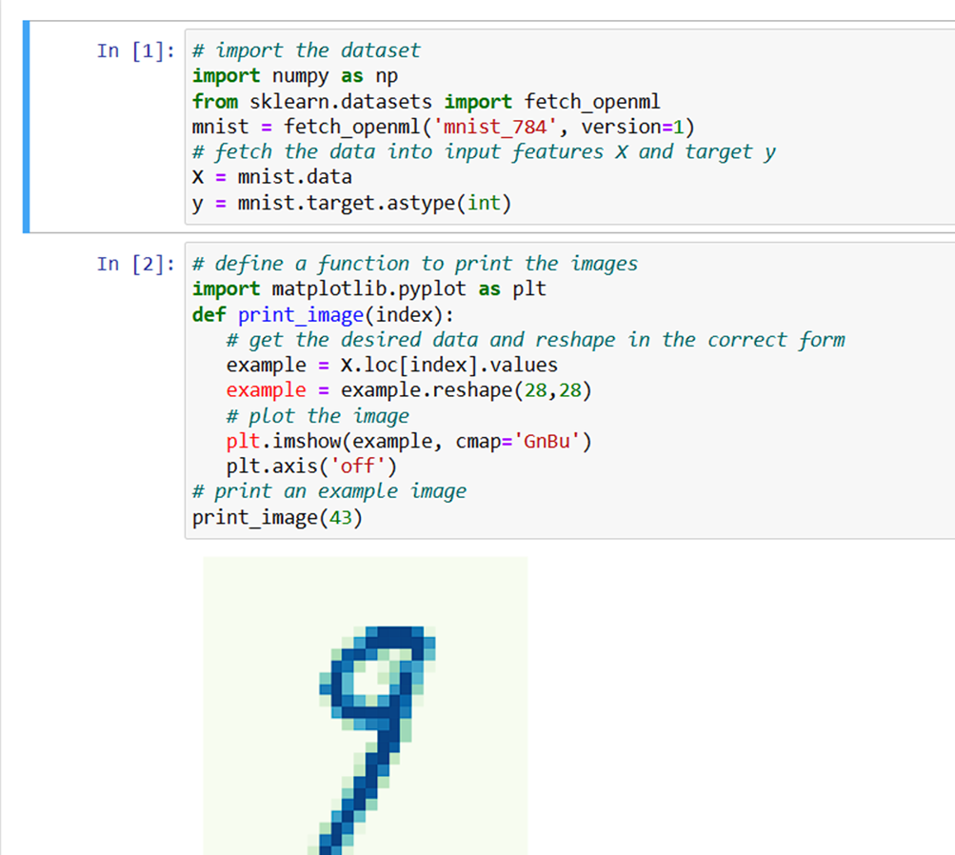
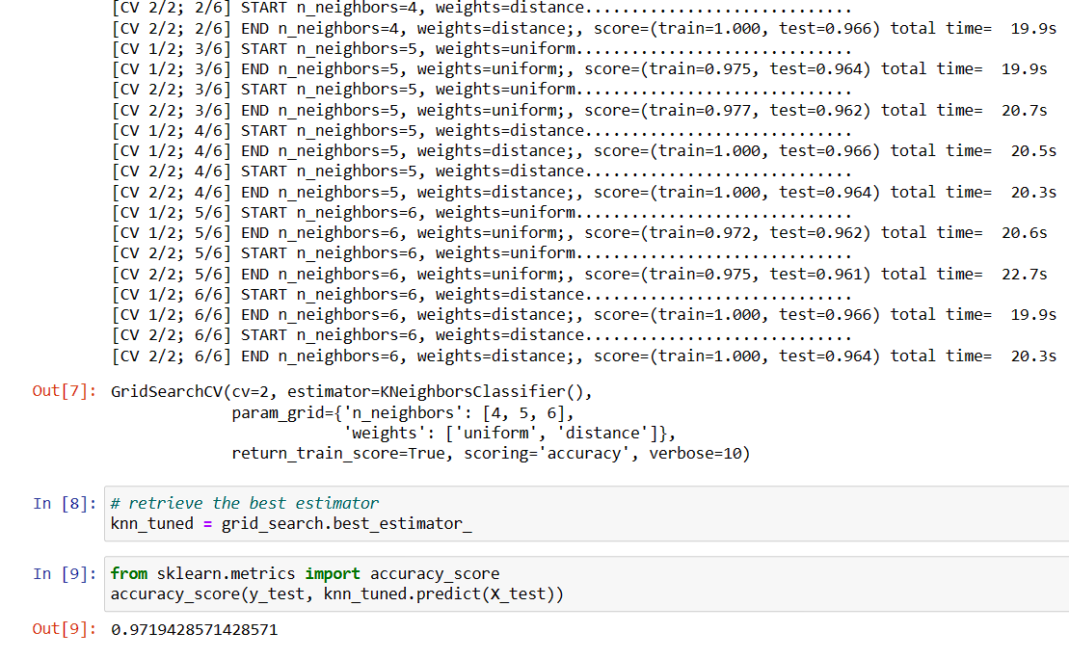
Code

Slide 9
Thank You!

